Slide 1
WEBRTC BASED MOBILE/CAR VOICE GEOTALK SYSTEM
CSE 496
First Presentation
Hasan Can İstekli
Advisor: Assoc. Prof. Dr. Mehmet Göktürk
October 2025

Slide 2
Contents
Project Definition
Project Design
Project Requirements
Success Criteria
Project Timeline

Slide 3
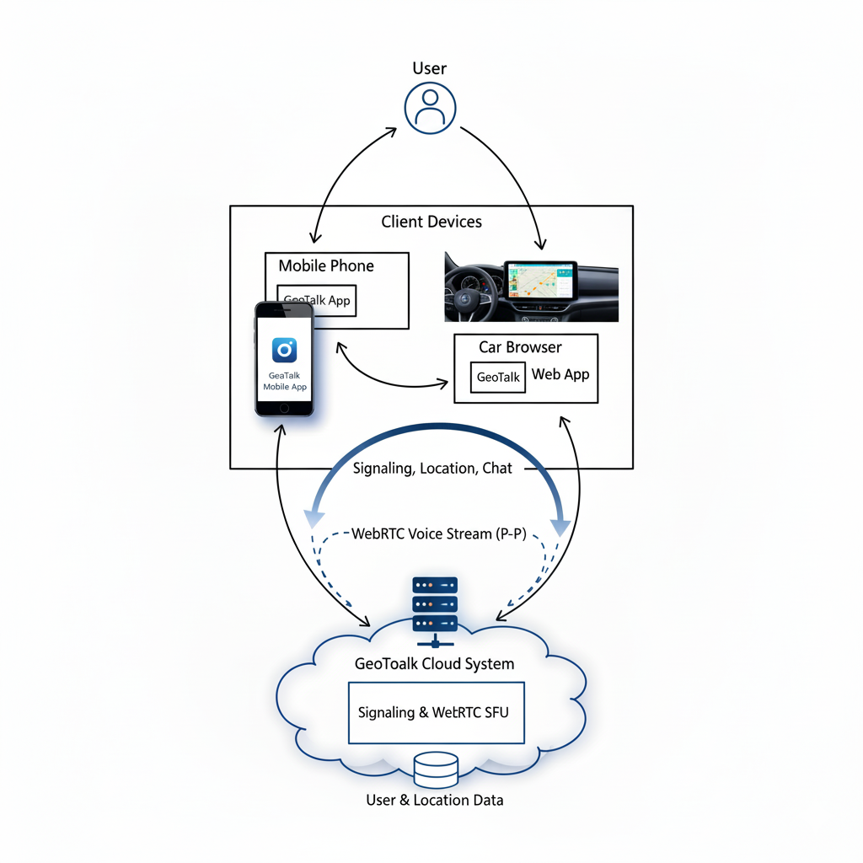
Project Definition
This project introduces "GeoTalk," a web-based communication platform for drivers. The system allows a group of users to:
See each other's real-time location on a map.
Communicate through voice channels using WebRTC technology.
Send and receive text messages.

Slide 4
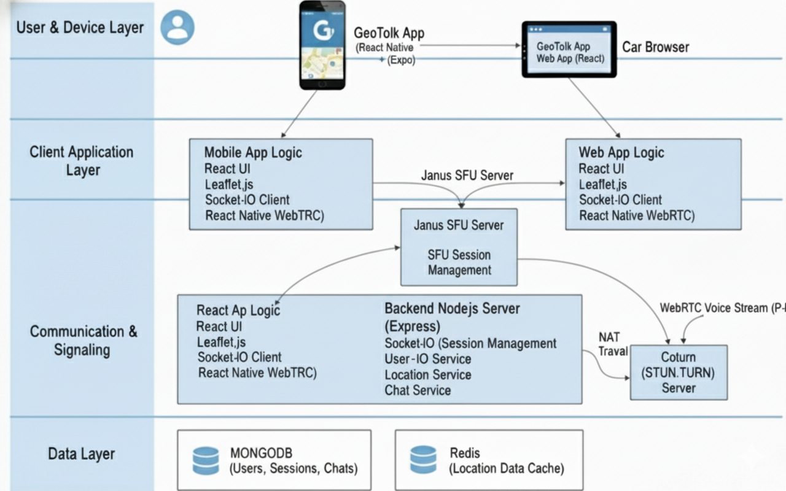
Project Design
A multi-layered architecture separates the UI, application logic, and data layers.
Clients are a React Native mobile app and a React web app for cars.
The Node.js backend handles signaling and SFU sessions, using MongoDB for data and Redis for location caching.
Voice communication is managed by a Janus SFU server, while Coturn ensures connection reliability.

Slide 5
Project Requirements
To develop this project, several software tools and technologies will be used:
Backend: Node.js, Express, Socket.IO (for signaling & SFU session management), JWT (for authentication).
Frontend: React (for the web/car browser app), React Native with Expo (for the mobile app).
Databases: MongoDB (for persistent user and session data), Redis (for location data caching).
Real-time Communication: Janus WebRTC Server (as an SFU), Coturn (STUN/TURN Server for NAT traversal), WebRTC libraries.
Cloud Server (VPS): To host the backend application (Node.js), databases, the Coturn server, and the Janus SFU Server.

Slide 6
Success Criteria
Qualitative (Verifiable) Criteria:
Group Communication: At least 5 users can talk in a room simultaneously.
Cross-Platform Support: Mobile and web clients can communicate in the same room.
Core Features Working: Live location, text chat, and listen-only mode are fully functional.
Quantitative (Measurable) Criteria:
Voice Latency: Audio delay is under 250ms.
Location Accuracy: Map location is within 20 meters of the actual position.
Location Update Rate: Map positions update at least every 5 seconds.

Slide 7
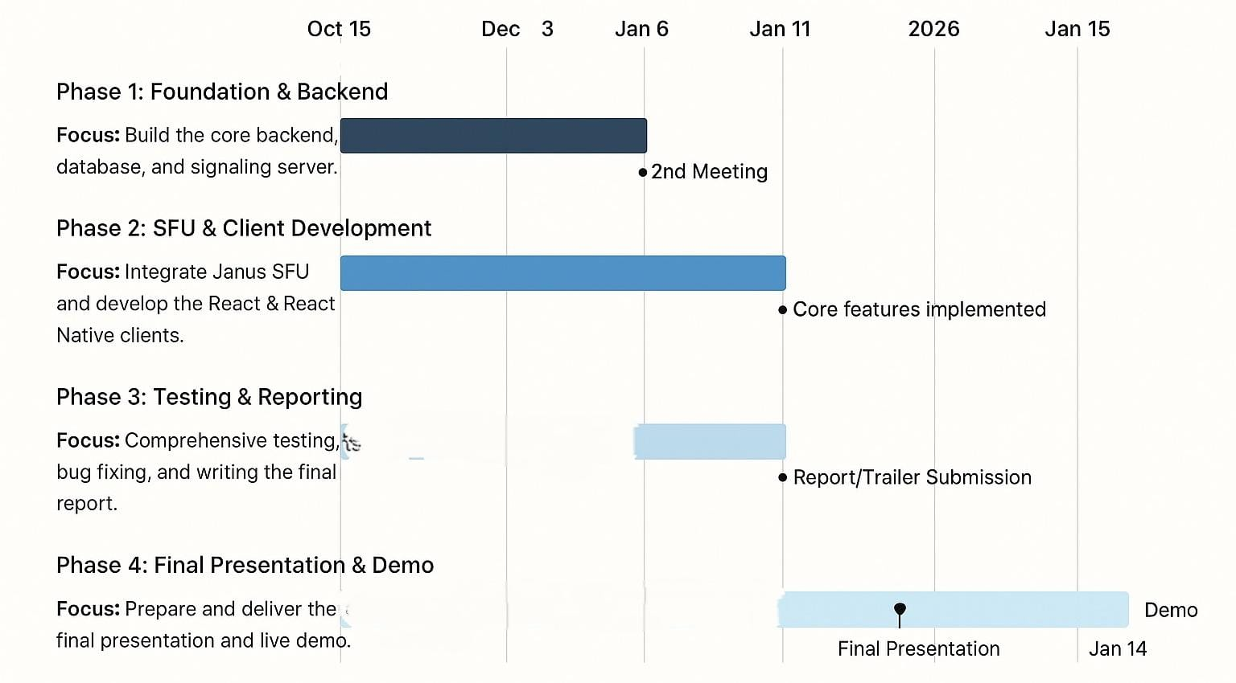
Project Timeline

